Slide 1
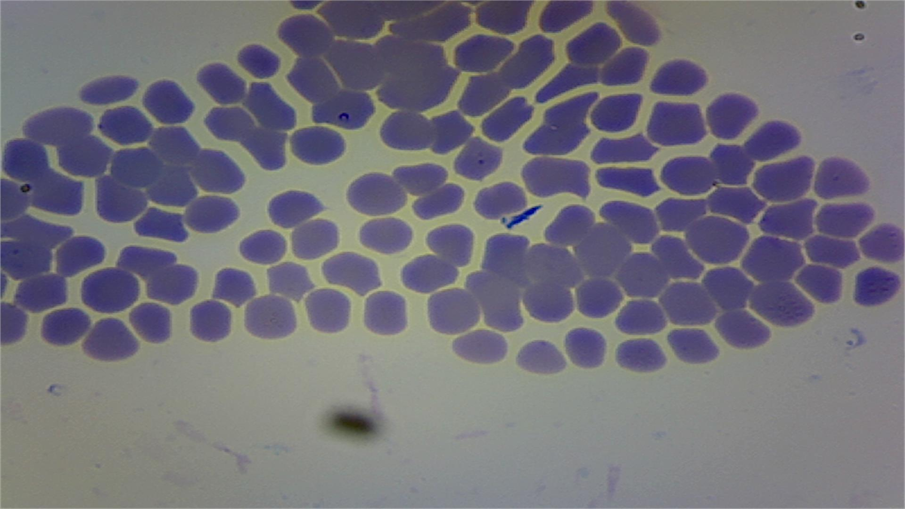
Theileriosis
Dr. Batool Salim
Fourth class
Department of Pathology and Poultry Disease/ Veterinary Medicine College

Slide 2
INRTODUCTION
                Bovine theileriosis is a tick born haemoprotozoan disease
It causes huge economic losses due to high incidence, mortality, weight losses, abortion and reduced milk yield
It is characterized by fever, anemia along with respiratory and digestive disorders

Slide 3
Etiology:
The causative agent, Theileria annulata, is found to be widely distributed in both Tropical and sub-tropical region
Transmission
The tick for transmitting causative agent Theileria annulata belongs to genus Hyalomma anatolicum anatolicum (Three host tick)
These are mostly two/three host ticks, preferring hot and humid climate for completion of their life cycle
Tick positive for infective stages of Theileria annulata acts as constant source of infection to susceptible animals

Slide 4
Pathogenesis
Sporozoites
Microschizonts
In lymphocytes
Kochs blue body
Micromerozoites
RBC
(Piroplasmosis)

Slide 5
Pathogenesis
Within host leukocytes, the parasite induces leukocyte cellular division, which expands the parasitized cell population.
Infected cells disseminate throughout the lymphoid system via the lymphatic and blood vessels.
The infected leukocyte may block capillaries, causing tissue ischemia.
This is followed later by necrosis of infected lymphoblasts induced by cytotoxic T-Lymphocytes. The severe lymphocytolysis often leads to immunosuppression.
Later in infection some schizonts cause leukocyte lysis and release of merozoites.
Merozoites then invade and parasitize erythrocytes, causing hemolytic anemia.

Slide 6
Clinical Signs
Swelling of the draining lymph node, usually the parotid
Fever 40–41oC, maintained until death or recovery
Nasal discharge, Lacrimation
Swelling of the eyelids and ears
Anemia, Jaundice, Anorexia, Heart beat rapid, dyspnea, diarrhea

Slide 7
Fig; Showing Theileria spp in blood slide

Slide 8
Post mortem Lesions
❖ Lymphocytes proliferate heavily invading multiple organs causing disease similar to a lymphoma (cancer of lymphocytes)
❖ Splenic enlargement.
❖ Severe pulmonary emphysema and edema along with hydrothorax and hydro pericardium.
❖ Generalized lymphoid hyperplasia.
❖ Small lymphoid nodules (the so-called pseudo-infarcts) are present in liver, kidney, and alimentary track.
❖ The carcass is emaciated and hemorrhages are evident in a variety of tissues and organs. Death is in most cases due to infiltration of the lung resulting in lung edema (the abnormal build up of fluid within the lung)

Slide 9
Bovine Diseases
intracellular parasites

Slide 10
Anaplasmosis
also known as yellow bag or yellow fever
Is an infectious parasitic disease of cattle caused by the microorganism anaplasma marginale. This parasite infects the red blood cells and causing anemia.

Slide 11
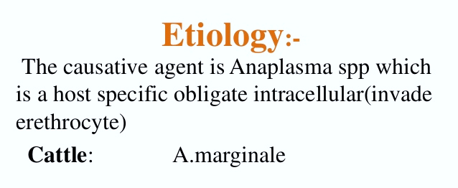
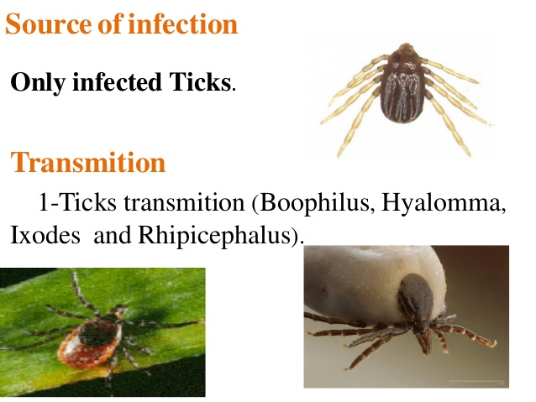

Slide 12
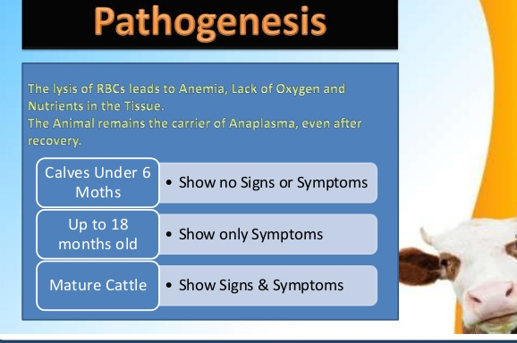

Slide 13
Clinical signs (acute form)
increase in severity as the animal ages. The first clinical sign is typically fever, ranging from 103º F to 106º F and lasting 12-24 hours.
Most other clinical signs are manifestations of acute anemia, including mucosal pallor, muscle weakness, tachycardia, tachypnea, exercise intolerance, and behavioral changes. Additional signs that may be present include depression, anorexia, dehydration, constipation, and frequent urination with dark yellow urine.
Hemoglobinuria does not occur because the anemia results from the destruction of parasitized erythrocytes in the spleen, not from intravascular hemolysis. Jaundice and weight loss may occur later in the disease. Milk production declines rapidly in dairy cows.

Slide 14
Chronic form
Anaplasmosis is manifested by slow recovery following acute disease, and it may persist for a period of between two weeks and three months. It is characterized by poor appetite, loss of weight and varying degrees of dehydration, anemia and icterus which are usually milder than in the acute disease

Slide 15
Lesions
are typical of those found in animals with anemia due to erythrophagocytosis.
- The carcasses of cattle that die from anaplasmosis are generally markedly anemic and jaundiced.
- Blood is thin and watery. The spleen is characteristically enlarged and soft, with prominent follicles.
- The liver may be mottled and yellow-orange. The gallbladder is often distended and contains thick brown or green bile. Hepatic and mediastinal lymph nodes appear brown.
- There are serous effusions in body cavities, pulmonary edema, petechial hemorrhages in the epi- and endocardium.
- often evidence of severe GI stasis. Widespread phagocytosis of erythrocytes is evident on microscopic examination of the reticuloendothelial organs.

Slide 16
Bovine Babesiosis
or red water is a tick-borne disease

Slide 17
Etiology :
- Babesia bovis, which causes Asiatic red water,
- Babesia bigemina, which causes African red water.
-Babesia divergens causes an economically important disease
Blood smear showing Babesia bigemina. Note large, round trophozoite (left)
Blood smear showing Babesia bovis. Note round trophozoites (bottom right)

Slide 18
PATHOGENESIS
1. The primary mechanism is intravascular haemolysis (leading to haemoglobinaemia and haemoglobinuria), resulting in anaemia, hypoxia and secondary inflammatory lesions in various organs, especially liver and kidneys.
2. The secondary mechanism is electrolyte imbalances, complement activation, coagulation disorders and release of pharmacologically active substances.
3. Centrilobular liver degeneration and degeneration of kidney tubule epithelium are caused by hypoxia and possibly by immunopathologic reactions.
4. Damage to kidney tubule epithelium impairs ion
exchange, resulting in H+ retention (leading to acidosis).

Slide 19
Clinical signs
1. In natural infections, incubation periods usually vary from 8 to 15 days.
2. In acute manifestations, fever (>40°C) is usually present for several days before the onset of other clinical signs
3. in appetence, depression, weakness and reluctance to move. Haemoglubinuria is often present especially in B. bigemina infections (hence the common name "redwater").
4. Anaemia and icterus are especially obvious. Diarrhoea is common and pregnant cows may abort.
5. Cerebral babesiosis, which occasionally develops in B. bovis infections, is manifested by hyperaesthesia, nystagmus, circling, head pressing, aggression, convulsions and paralysis

Slide 20
pathology
1. babesiosis is characterised by light red, watery blood and the mucous membranes and carcase are paler than normal (these changes are due to anaemia). In many cases this pallor may be masked by icterus .
2. The spleen is invariably enlarged and has a pulpy consistency (severe congestion). The liver is swollen, friable and yellowish-brown in colour (degeneration, bile stasis). The hepatic surface may have an evenly mottled appearance, with lighter coloured periacinar areas (fatty degeneration to necrosis)
3. The gall-bladder is distended with viscous bile which often contains dark brown granules up to 1 mm in diameter. The intestinal content is usually diminished and yellowish in colour (bile-stained).
4. The kidneys are mildly to moderately swollen and dark reddish-brown in colour (haemoglobinuric nephrosis) or yellowish-brown.
5. The lungs are often oedematous, with foam present in the bronchi and trachea. The heart itself is usually flabby and pale (degeneration, anaemia) and endocardial and epicardial petechiae and ecchymoses may be present.

